Slide 1
Automating measurement of extensional fault/fold scarp geometry and resurfacing in Reykjanes, Iceland: Implications for fault scaling and growth
By Maddie Schwarz
Department of Geological Sciences
April 5, 2021

Slide 2
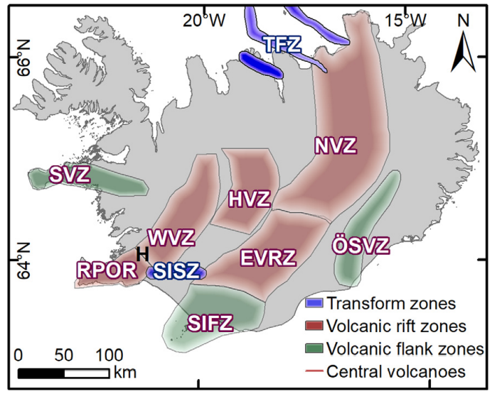
Overview of Iceland
Plume Ridge-Interactions
Recorded within rifts and volcanic centers
Fantastic laboratory for studying the interplay between crusting, thinning, and magmatism
MAR is migrating to the west, but has been ‘captured’ but the hotspot
Over geologic time, the MAR will break away and reestablish itself in a more efficient geometry

Slide 3
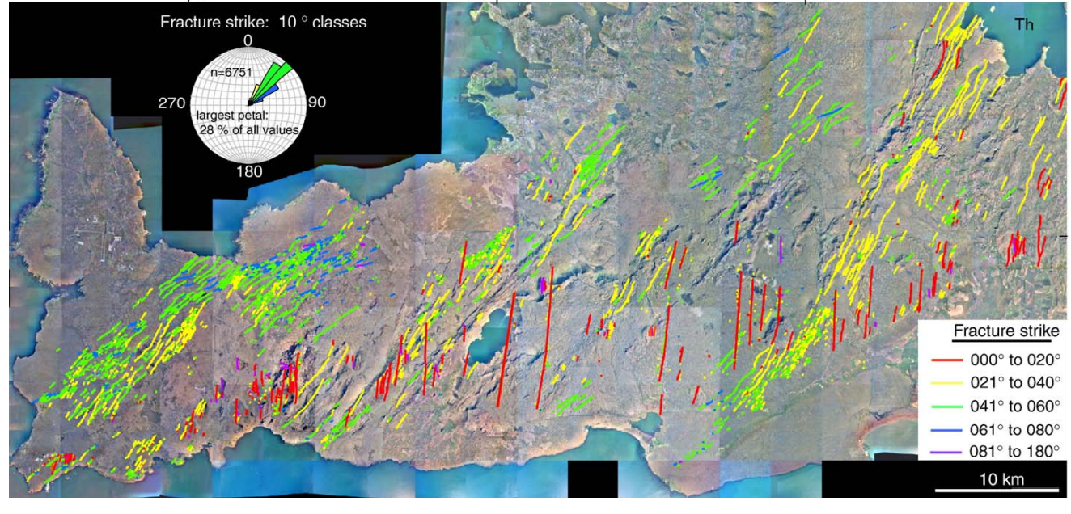
Reykjanes Peninsula
Onshore expression of the Mid-Atlantic Ridge
Young, basaltic landscape that is repeatedly resurfaced
post glacial, last 12ka
last eruption~800 yrs ago
Consists of normal faults, oblique-slip faults, and eruptive fissures

Slide 4
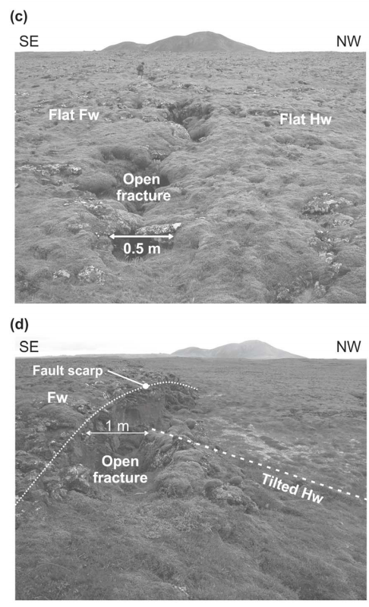
Extensional Structures of the Reykjanes
open fractures on relatively flat topography
2) fault propagation folds, with a secondary open, dilatant fracture on a primary monocline

Slide 5
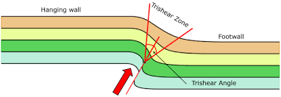
Trishear Kinematic Model
Physical or computational model of fold growth through time
Normal fault buried by overlaying strata
Deformation occurs in a triangular zone in front of the propagating fault tip
Envelope and fold geometries depend on fault dip, trishear angle, trishear symmetry, and overlaying cover thickness

Slide 6
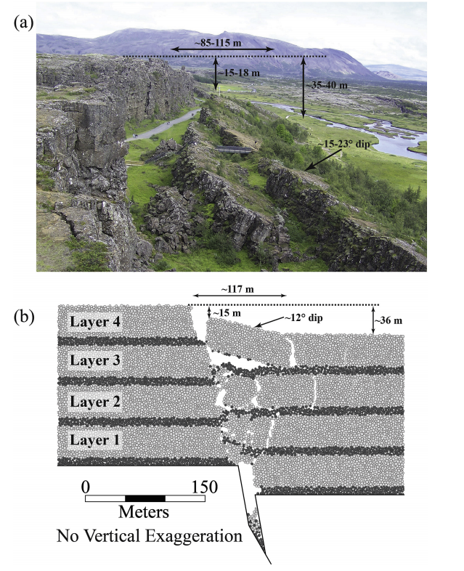
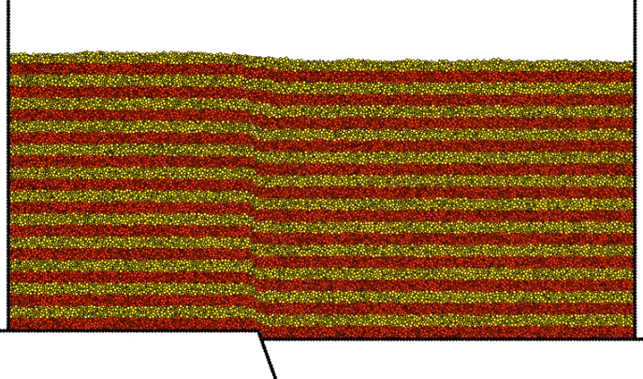
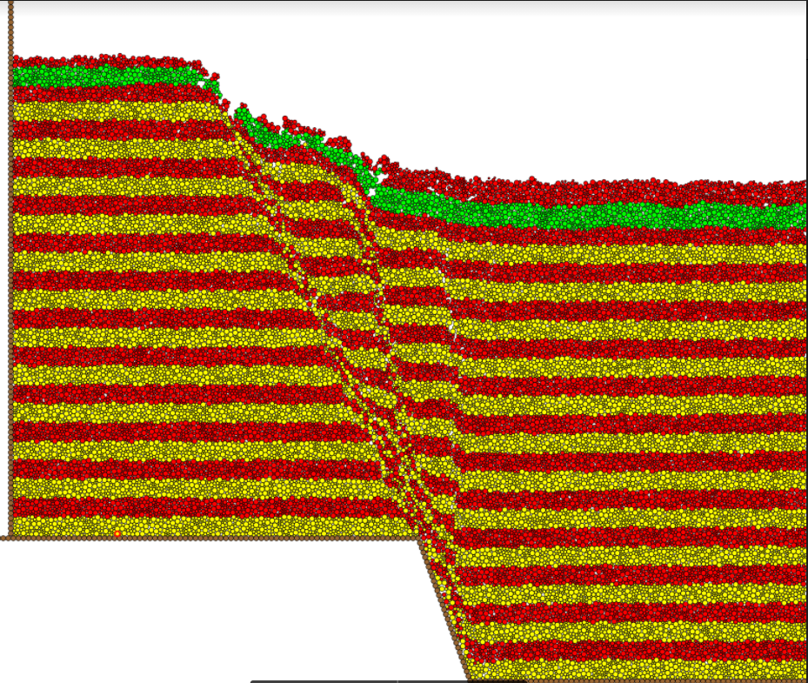
Discrete Element Models: Stuart Hardy
Normal Fault growth + Resurfacing
Thingvellir Model (2013)
Newly deposited basalt layers

Slide 7
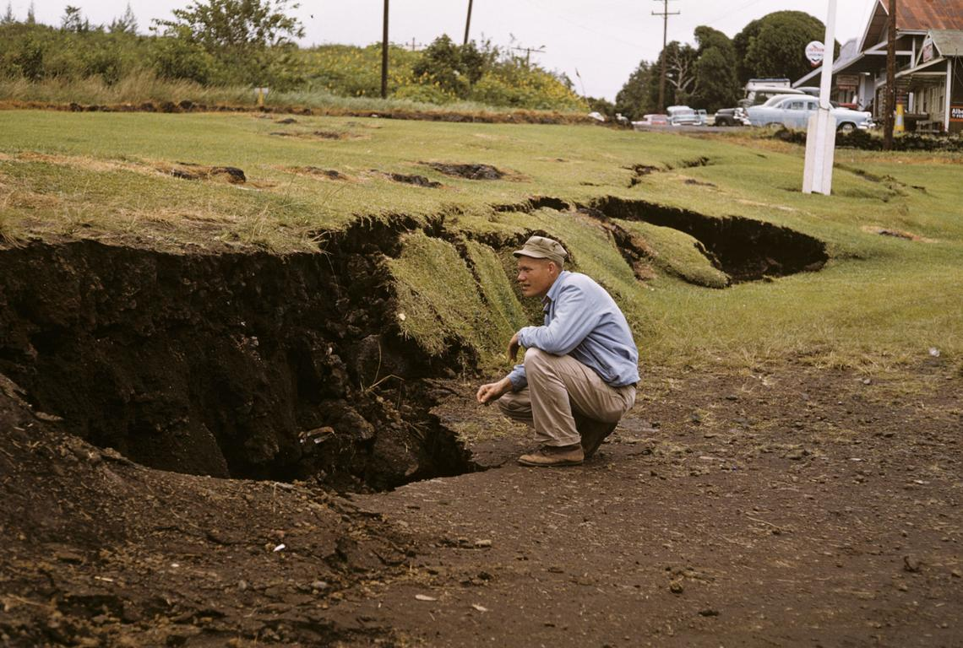
Displacement Scaling
D:L profiles measure vertical offset along a fault scarp’s length
Vertical separation is used as a proxy for fault slip along individual fault scarps
Displacement scaling is used to constrain the propagation history of active extensional fault systems at the land surface
Vertical offset
Length

Slide 8
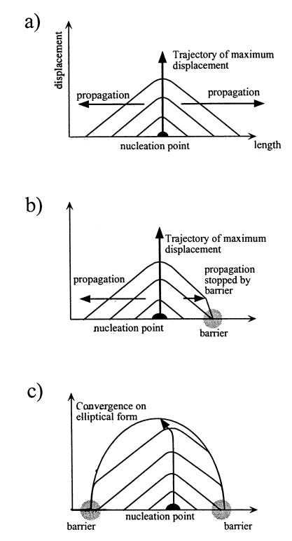
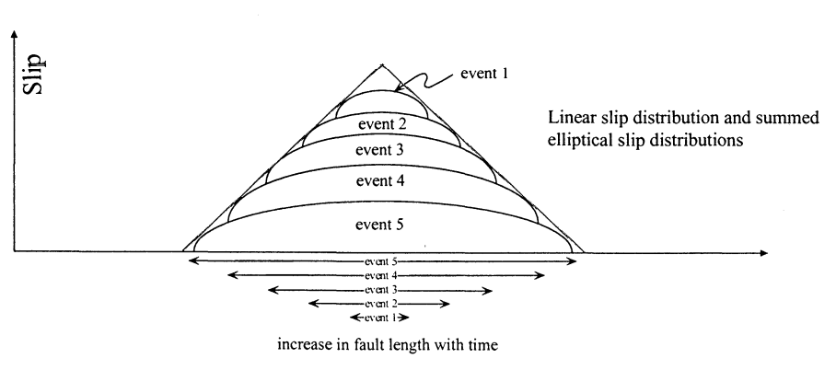
Displacement Scaling
Idealized linear fault growth is characterized by a 1st order, triangular D:L profile (a)
Greatest amount of slip is at the fault center (initiation point) and decreases towards tips
Barriers to fault growth cause restriction at fault tips; cause changes in profile shape (b, c)
Asymmetry in the profile is the result of the fault propagating in a particular direction (b)

Slide 9
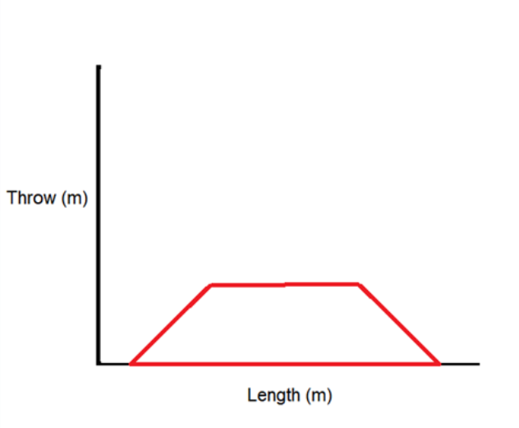
D:L of Resurfaced Faults
Based off the linear growth model, an idealized propagating fault that is covered by a resurfacing event will be trapezoidal in shape

Slide 10
Research Goals
1) Develop automated methods for mapping fault scarp extents using high resolution digital elevation data
2) Develop automated methods for determining displacement scaling relationships along faults
3) Use these methods to further our understanding of fault and fold growth in 3D – particularly for resurfaced landscapes

Slide 11
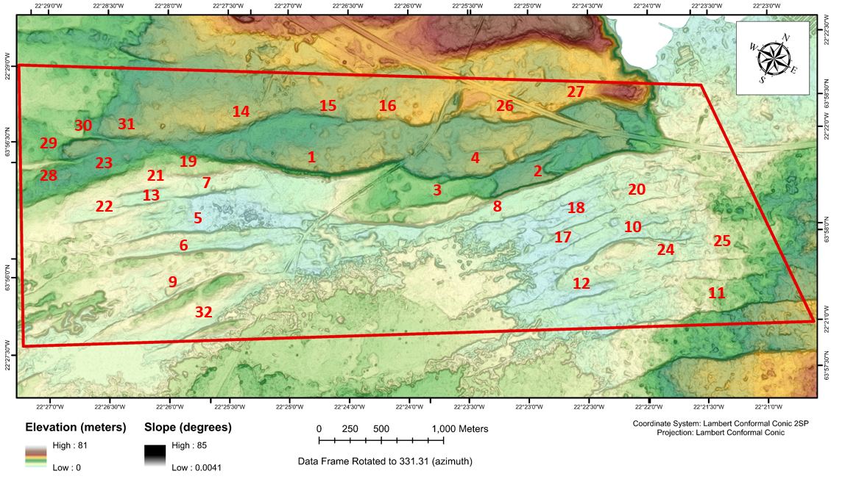
Vogar Study Site
55 scarps/scarp segments total
Structures are in different stages of evolution
Extents are mapped using ML algorithms
32 scarps are chosen for scaling analysis

Slide 12
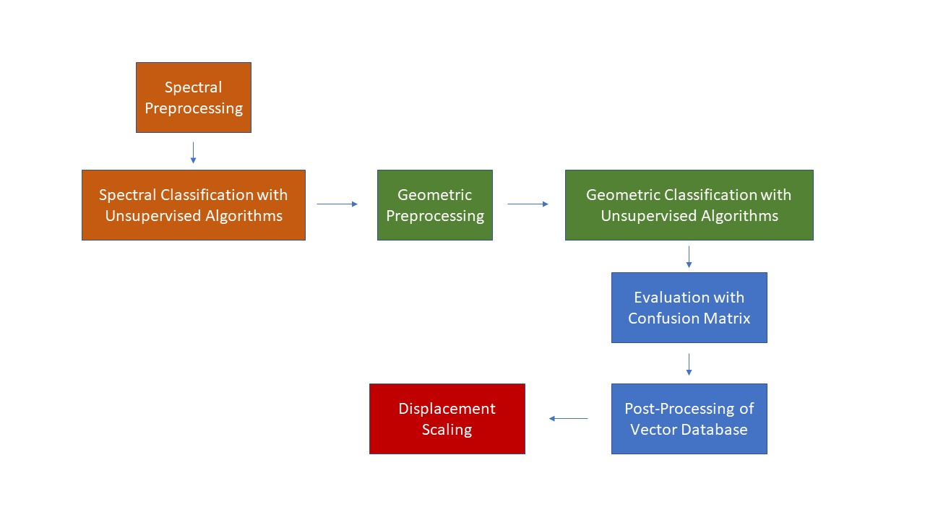
Methodology
Figure 3 Summary of automated mapping workflow.

Slide 13
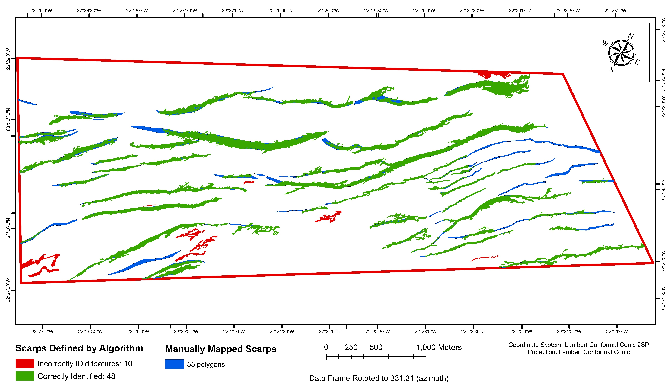
Automated Mapping Results
48 scarps/segments identified by algorithms
10 lava flow edges misidentified as scarps
Accuracy Assessment:
Mapping Accuracy: ~76%
Misclassification Rate: ~42%
% error: 29.4%.

Slide 14
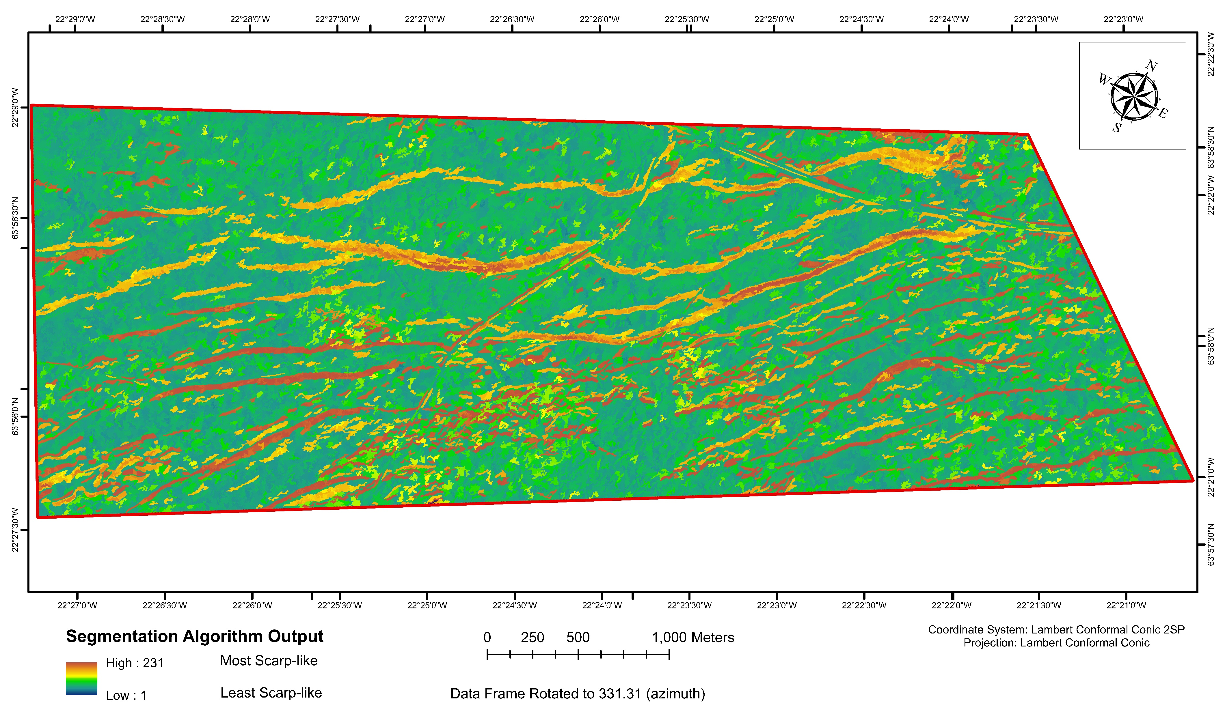
Algorithm Findings: Segment Mean Shift
Visualizes morphological differences in scarps

Slide 15
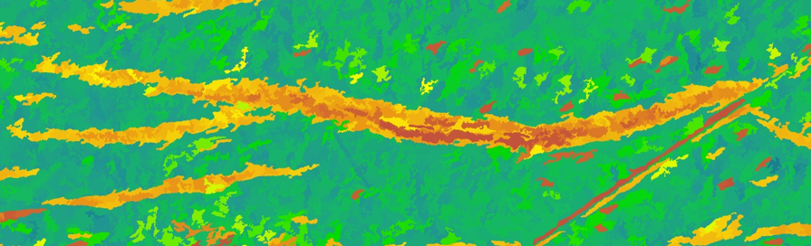
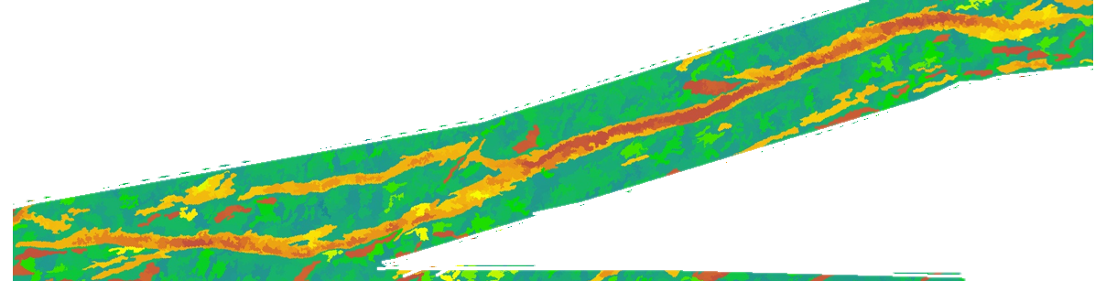
Red portions of scarps correlate to peaks in displacement in D:L profiles

Slide 16
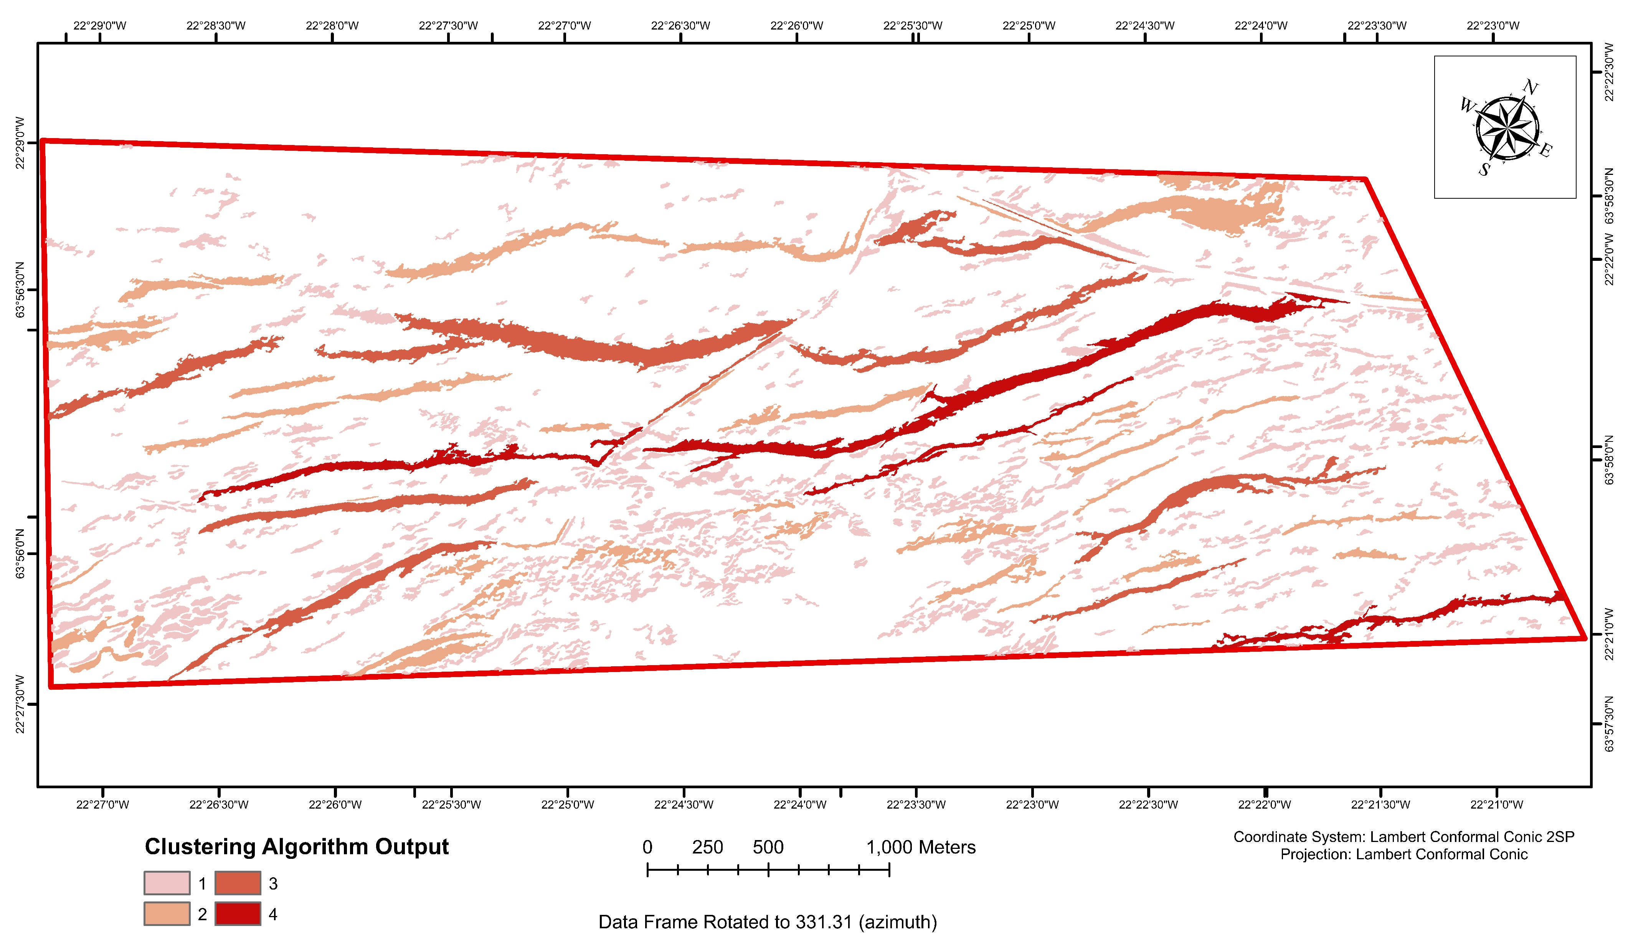
Algorithm Findings: ISO Cluster Unsupervised
Output classes for geometric analysis identify differences in scarp shape
Elongation, length, curl
The most interesting geometric parameter is scarp width
In this image, quantified with elongation due to geometric algorithm constraints
Distinctions made by the algorithm based on scarp shape can be related to trishear parameters and resurfacing events
Wider scarps are likely indicative of older, buried faults with thick overlaying cover layers

Slide 17
Displacement Scaling Results
32 scarps evaluated
11 show an overall first-order triangular shape
21 show an overall plateau shape
5 are asymmetrical, indicating propagation direction
At least 4 are the result of fault linkage
Triangular
Plateau
Asymmetrical Plateau

Slide 18
Scaling Interpretation
Small, triangular shaped profiles are young faults that formed since the last eruptive resurfacing event
Small, plateau shaped profiles are likely due to restriction at the faults’ tips from being covered during previous resurfacing events
Large, plateau shaped profiles result from fault linkage
Predominance of plateau-shaped profiles suggests resurfacing events have influenced fault and fold growth within this region

Slide 19
Conclusions
Automated methods expedite the fault mapping process and scaling analyses
Weighted Overlay schemes highlight topographic features in DEMs
Unsupervised Algorithms in OBIA schemes can detect and map large, obvious fault scarps
Segmentation Algorithms effectively visualize scarp morphology in map view
Displacement scaling of faults within the Vogar study site show resurfacing events influence how faults and folds grow in three dimensions

Slide 20
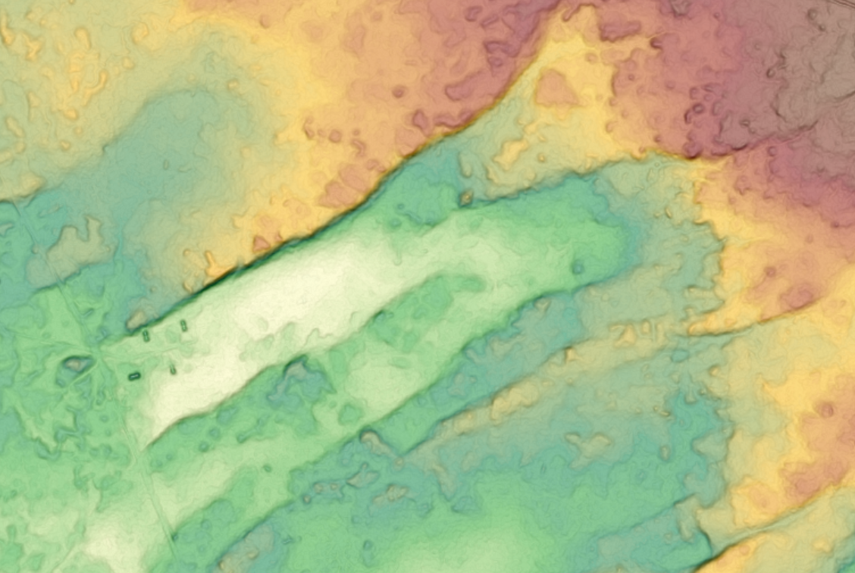
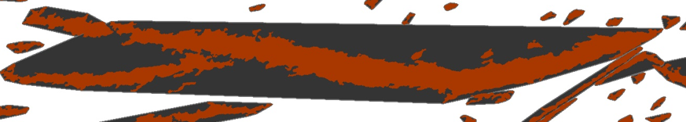
Limitations of Methodology
DEM data resolution
Limits the detection of smaller, subtler scarps
Limits the accuracy of D:L profiles
Unsupervised Algorithms
Internal computational thresholds limit mapping and classification capabilities
Geometric Analysis
Convex hull is an inexact measurement of shape morphology
To get more accurate measurements of scarp width, a more complex geometric algorithm is required

Slide 21
Further Research
How much resurfacing have these faults seen?
How does resurfacing constrain fault and fold growth quantitatively?
How does scarp width relate to subsurface deformation quantitatively?
Further quantitative analysis of D:L profiles
Combine profiles of linking scarps
Visualize the “size” of the fault had it not been buried
Combine automated measurements with discrete element models of extensional structures
Explore the relationship between scarp width, cover thickness, and trishear envelope
Observe scaling relationships at different stages of model fault evolution
Use more complex shape analysis algorithms to more accurately measure scarp widths and relate this to D:L profiles and trishear models

Slide 22
References
Basharat, M. et al. (2016). “Landslide susceptibility mapping using GIS and weighted overlay method: a case study from NW Himalayas, Pakistan.” Arab J Geosci 9, 292 (2016). doi: https://doi.org/10.1007/s12517-016-2308-y
Bubeck et al. (2018). “Normal fault growth in layered basaltic rocks: The role of strain rate in fault evolution.” Journal of Structural Geology vol. 115, pp. 103–120, doi: https://doi.org/10.1016/j.jsg.2018.07.017
Chen, Zhiang et al. (2020). “Geomorphological Analysis Using Unpiloted Aircraft Systems, Structure from Motion, and Deep Learning.” 2020 IEEE/RSJ International Conference on Intelligent Robots and Systems (IROS), Las Vegas, NV, USA, 2020, pp. 1276-1283, doi: 10.1109/IROS45743.2020.9341354.
Clifton, A.E., Kattenhorn, S.A. (2006). “Structural architecture of a highly oblique divergent plate boundary segment.” Tectonophysics, vol. 419, pp. 27–40. doi:10.1016/j.tecto.2006.03.016
Hardy, Stuart. (2013). “Propagation of blind normal faults to the surface in basaltic sequences: Insights from 2D discrete element modelling.” Marine and Petroleum Geology vol. 48, pp. 149-159. Doi: http://dx.doi.org/10.1016/j.marpetgeo.2013.08.012
Ito, G. et al. (2003). “Observational and Theoretical Studies of the Dynamics of Mantle Plume-Mid-Ocean Ridge Interaction.” Rev. Geophys., 41(4), 1017, doi:10.1029/2002RG000117.
Juliani, Cyril. (2019). “Automated Discrimination of Fault Scarps along an Arctic Mid-Ocean Ridge Using Neural Networks.” Computers & Geosciences, vol. 124, pp. 27–36., doi:10.1016/j.cageo.2018.12.010.
Manighetti, I. et al. (2001). “Slip accumulation and lateral propagation of active normal faults in Afar.” Journal of Geophysical Research, vol. 106, no. B7, Pages 13, 667-13,696, July 10, 2001.
Mittelstaedt, Eric et al. (2011). “Repeat ridge jumps associated with plume-ridge interaction, melt transport, and ridge migration.” Journal of Geophysical Research, vol. 116, B01102 , doi:10.1029/2010JB007504.
Nyberg, Bjorn, et al. (2015). “Geometric attribute and shape characterization of modern depositional elements: A quantitative GIS method for empirical analysis.” Computers & Geosciences, vol. 82, pp. 191-204, doi: http://dx.doi.org/10.1016/j.cageo.2015.06.003
Porter, Claire et al. (2018). “ArcticDEM”, https://doi.org/10.7910/DVN/OHHUKH
Pawłuszek, K et al. (2019). Multi-Aspect Analysis of Object-Oriented Landslide Detection Based on an Extended Set of LiDAR-Derived Terrain Features. ISPRS Int. J. Geo-Inf. 2019, 8, 321.

Slide 23
Rau, J.Y. et al. (2017). “Bridge Crack Detection using Multi-Rotary UAV and Object- Base Image Analysis.” The International Archives of the Photogrammetry, Remote Sensing and Spatial Information Sciences, Volume XLII-2/W6.
Sare, Robert, et al. (2019). “Regional‐Scale Detection of Fault Scarps and Other Tectonic Landforms: Examples From Northern California.” Journal of Geophysical Research: Solid Earth, vol. 124, no. 1, pp. 1016–1035., doi:10.1029/2018jb016886.
Sholes, Steven et al. (2013). Object Based Image Analysis for Remote Sensing of Planetary Surfaces. 1527.
Smart, Kevin J. & Ferrill, David A. (2018). “Discrete element modelling of extensional fault- related monocline formation.” Journal of Structural Geology, Volume 115, Pages 82-90, ISSN 0191-8141, https://doi.org/10.1016/j.jsg.2018.07.009.
Sigmundsson, Freysteinn et al. (2017). “Geodynamics of Iceland and the signatures of plate spreading.” Journal of Volcanology and Geothermal Research Volume 391,1 06436, ISSN 0377-0273, https://doi.org/10.1016/j.jvolgeores.2018.08.014.
Trippanera, D. et al. (2017). “Fault and graben growth along active magmatic divergent plate boundaries in Iceland and Ethiopia.” Tectonics, 34, 2318–2348, doi:10.1002/2015TC003991.
Thamilselvana, P. & Sathiaseelan, J. G. R. (2015). "A Comparative Study of Data Mining Algorithms for Image Classification", IJEME, vol.5, no.2, pp.1-9. DOI: 10.5815/ijeme. 2015.02.01.
Weih, R., Riggan, N.D. (2010). Object-Based Classification vs. Pixel-Based Classification: Comparative Importance of Multi-Resolution Imagery.
Wirth, Michael A. (2004). “Shape Analysis & Measurement,” lecture notes, Computing and Information Science Image Processing Group, University of Guelph. http://www.cyto.purdue.edu/cdroms/micro2/content/education/wirth10.pdf
Young, Elaine K. et al. (2020). “Testing the Reproducibility of Remote Surface Rupture Maps of the 2019 Ridgecrest Earthquakes.” Poster presented at: SCEC annual meeting, September 14-17, 2020.

